Slide 1
Drugs used in headache
Prof Asita de Silva

Slide 2
Headache burden
Headache has been underestimated, under-recognized and under-treated throughout the world - WHO

Slide 3
Headache : causes
- Tension Headache
- Migraine
- Cluster Headache
- Temporal arteritis
- Sinusitis
- Increased intracranial pressure

Slide 4
General management : analgesics
Specific management : depends on aetiology

Slide 5
Analgesics

Slide 6
Paracetamol
NSAIDs → Cox-2 selective
Celecoxib
Meloxicam
→ Non-cox-2 selective
Aspirin
Ibuprofen
Diclofenac
Indomethacin
Mefenamic acid (premenstrual headache)

Slide 7
Paracetamol

Slide 8
Mechanism of action
Paracetamol : Inhibits prostaglandin synthesis
only in brain
Adverse Effects
Usually well tolerated
Allergic reactions - sometimes
Analgesic nephropathy – chronic use

Slide 9
NSAIDs

Slide 10
Mechanism of Action
NSAIDs : Inhibit prostaglandin synthesis
central and peripheral
Phospholipids
Phospholipase A₂
Arachidonic acid
(-)
Cyclo-oxygenase NSAIDs
Cyclic endoperoxides
Prostaglandins, prostacyclins, thromboxane

Slide 11
Adverse Effects
Gastrointestinal – mucosal damage
dyspepsia, gastritis, peptic ulcers, GI bleeding
Renal - acute tubular necrosis → renal failure
- acute interstitial nephritis
- glomerulonephritis
- renal papillary necrosis → analgesic nephropathy
Sodium and fluid retention
Hypersensitivity reactions
precipitation of asthma
thrombocytopenia

Slide 12
Migraine

Slide 13
Migraine
A chronic neurological disorder
Most often begins at puberty and affects between 35 and 45 years
It is caused by the activation of a mechanism deep in the brain that leads to release of pain-producing inflammatory substances [5-HT (Serotonin)] around the nerves and blood vessels of the head
Characterized by moderate to severe headaches often in association with a number of autonomic symptoms
Typically the headache affects one half of the head, is pulsating in nature, and lasts from 2 to 72 hours
Associated symptoms may include nausea, vomiting, and sensitivity to light , sound or smell
The pain is generally made worse by physical activity
Migraine is recurrent, and often life-long

Slide 14
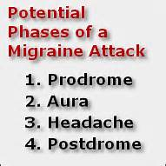
Migraine Phases

Slide 15

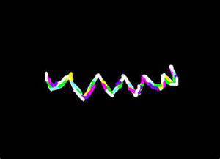
Migraine aura

Slide 16
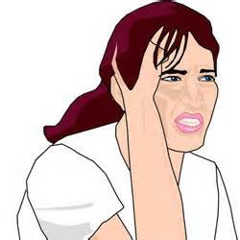
Interferes with ADL

Slide 17
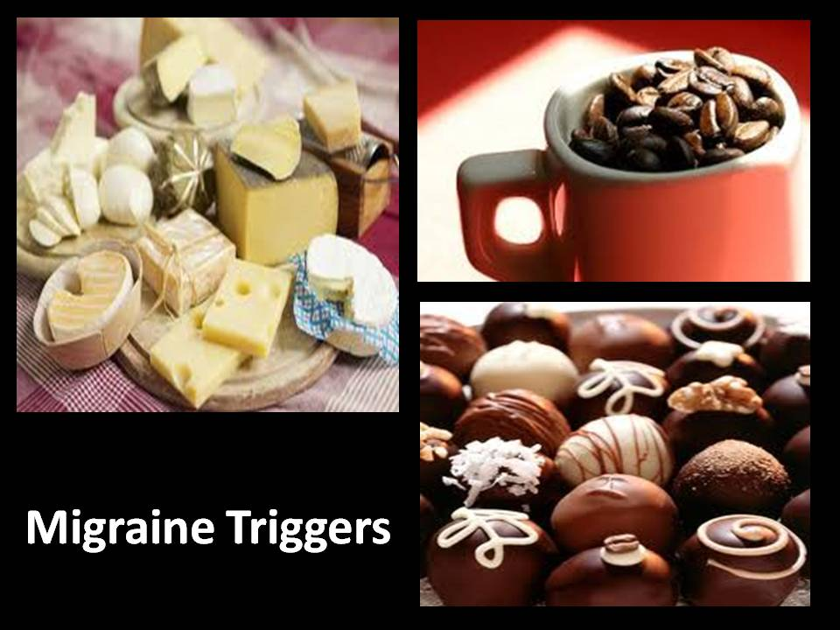
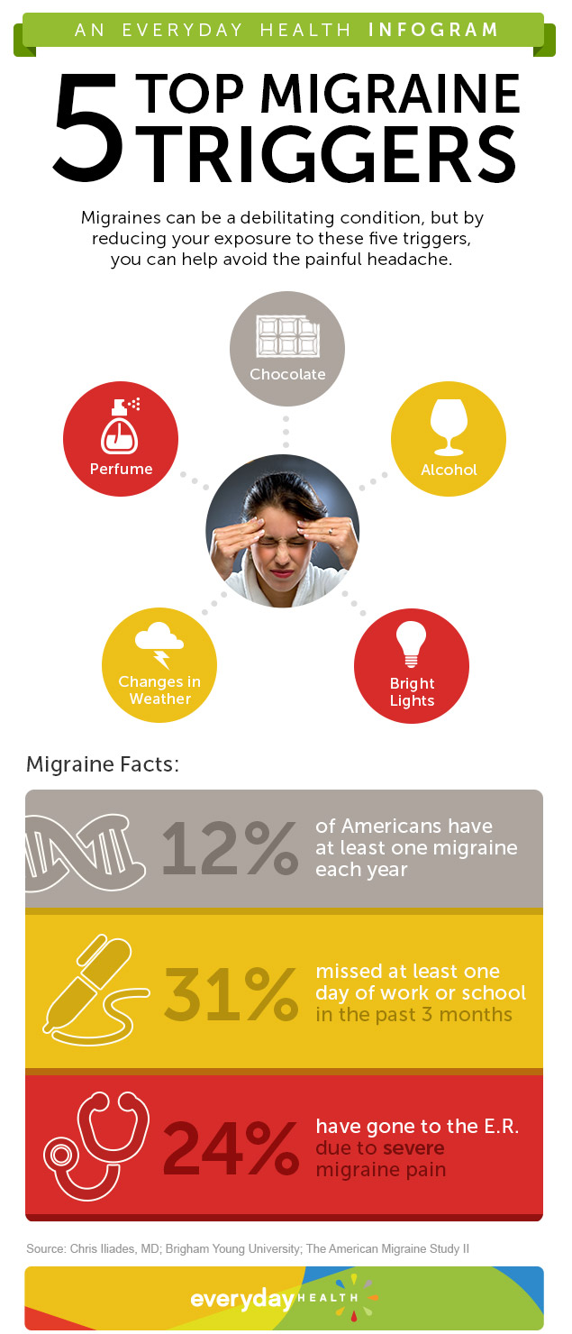

Migraine triggers

Slide 18
Drugs Used In Migraine
Two basic groups
Acute attack treatment
Migraine specific Rx
Migraine non-specific Rx
Prophylactic treatment

Slide 19
Drugs Used In Migraine ...
Acute attack treatment | Prophylactic treatment
Migraine non-specific Rx Analgesics PCM, NSAIDS, Antiemetics Domperidone Metoclopramide Migraine specific Rx 5-HT agonists Triptans | Beta-blockers Propranolol, Metoprolol Ca-channel blockers Verapamil Flunarizine Antiepileptics Topiramate Sodium valproate Antidepressants Amitriptyline 5-HT antagonists Pizotifen

Slide 20
Acute Attack Treatment ...
To relieve the symptoms after onset of attack
Disease non-specific treatment
- Paracetamol
- NSAIDS
- Anti-emetics (domperidone, metoclopramide)
Disease specific treatment
- Triptans (Sumatriptan, Zolimitriptan)
- (Ergotamine)

Slide 21
Acute Attack Treatment ...
Treatment should be started early in the attack
Disease specific treatment
- when simple measures fail
- when more aggressive therapy is indicated
Addition of anti-emetics is helpful
- enhance gastric emptying
- enhance absorption of drugs
- relieve nausea & vomiting

Slide 22
Acute Attack Treatment ...
Sumatriptan
The preferred disease specific treatment
5-HT₁ receptor agonist vasoconstriction
High 1st pass metabolism
Routes & doses: Nasal spray – 20mg
Subcutaneous – 6mg
Oral – 50mg

Slide 23
Acute Attack Treatment ...
Sumatriptan …
AE: nausea & vomiting, general malaise
dizziness, vertigo, sedation
altered sensation
transient increase in BP
may precipitate angina
CI - ischaemic heart disease, PVD
- uncontrolled hypertension

Slide 24
Prophylactic Treatment
Frequent attacks → marked disability
Frequent intake of acute attack medication may aggravate headache frequency
(refractory daily or near daily headache)
Prophylactic treatment

Slide 25
Prophylactic Treatment
Depends on
- frequency of attacks
- tolerability of attacks
severity
response to acute attack Rx
individual factors

Slide 26
Prophylactic Treatment ...
Beta-blockers – propranolol, metoprolol
Ca channel blockers – flunarizine, verapamil
Antiepileptics - topiramate
sodium valproate
gabapentin
Tricyclic antidepressants – amitriptyline
5-HT antagonists – pizotifen

Slide 27
Prophylactic Treatment …
Beta blockers
Propranolol, metoprolol,
Mechanism - ? modulation of central neurotransmitters
not its beta-blocking action
Propranolol dose: (usually 20 mg bd) 80-240mg daily in divided doses
AE: bradycardia, hypotension,
peripheral vasoconstriction
bronchospasm
fatigue, loss of energy, sleep disturbances
CI: bronchial asthma, severe bradycardia, PVD

Slide 28
Prophylactic Treatment ...
Flunarizine
Cerebro-selective Ca channel blocker
antihistamine activity as well
Given orally 5mg-15mg at night
AE: weight gain
tiredness
depression

Slide 29
Prophylactic Treatment ...
Topiramate
25 mg at night → 25 - 50mg bd
AE: weight loss, GI disturbances, dizziness, drowsiness, mood changes, myalgia
Sodium valproate
200mg bd → 400mg - 600mg bd
AE: drowsiness, weight gain, hair loss, liver toxicity, teratogenicity

Slide 30
Prophylactic Treatment ...
Pizotifen
A 5-HT antagonist vasodilatation
Given orally 0.5-3mg at night
AE: increased appetite & weight gain
drowsiness
anti-muscarinic effects
enhances the action of alcohol on brain

Slide 31
Prophylactic Treatment ...
Amitriptyline
A tricyclic anti-deppressant
Effective even if patient is not depressed
Start with 12.5mg at night; maintenance: 50-75mg
AE : dry mouth, blurred vision, constipation, sedation, urine retention, arrhythmias, confusion

Slide 32
Non-Pharmacological Aspects
Explaining to the patient
It is not curable but it can be controlled
It takes time
It is not a life-threatening condition
Life style modification
Identification & avoidance of precipitants
Regular habits

Slide 33
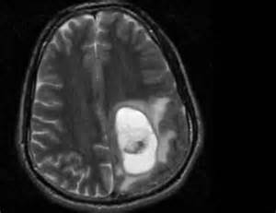
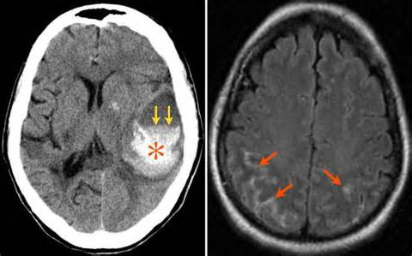
Not every headache is migraine
Tumors
Haemorrhages

